Slide 1
Focused Crawling for Structured Data DSCI550
Presentation Paper
Yifan Yang
8386626967
yyang295@usc.edu

Slide 2
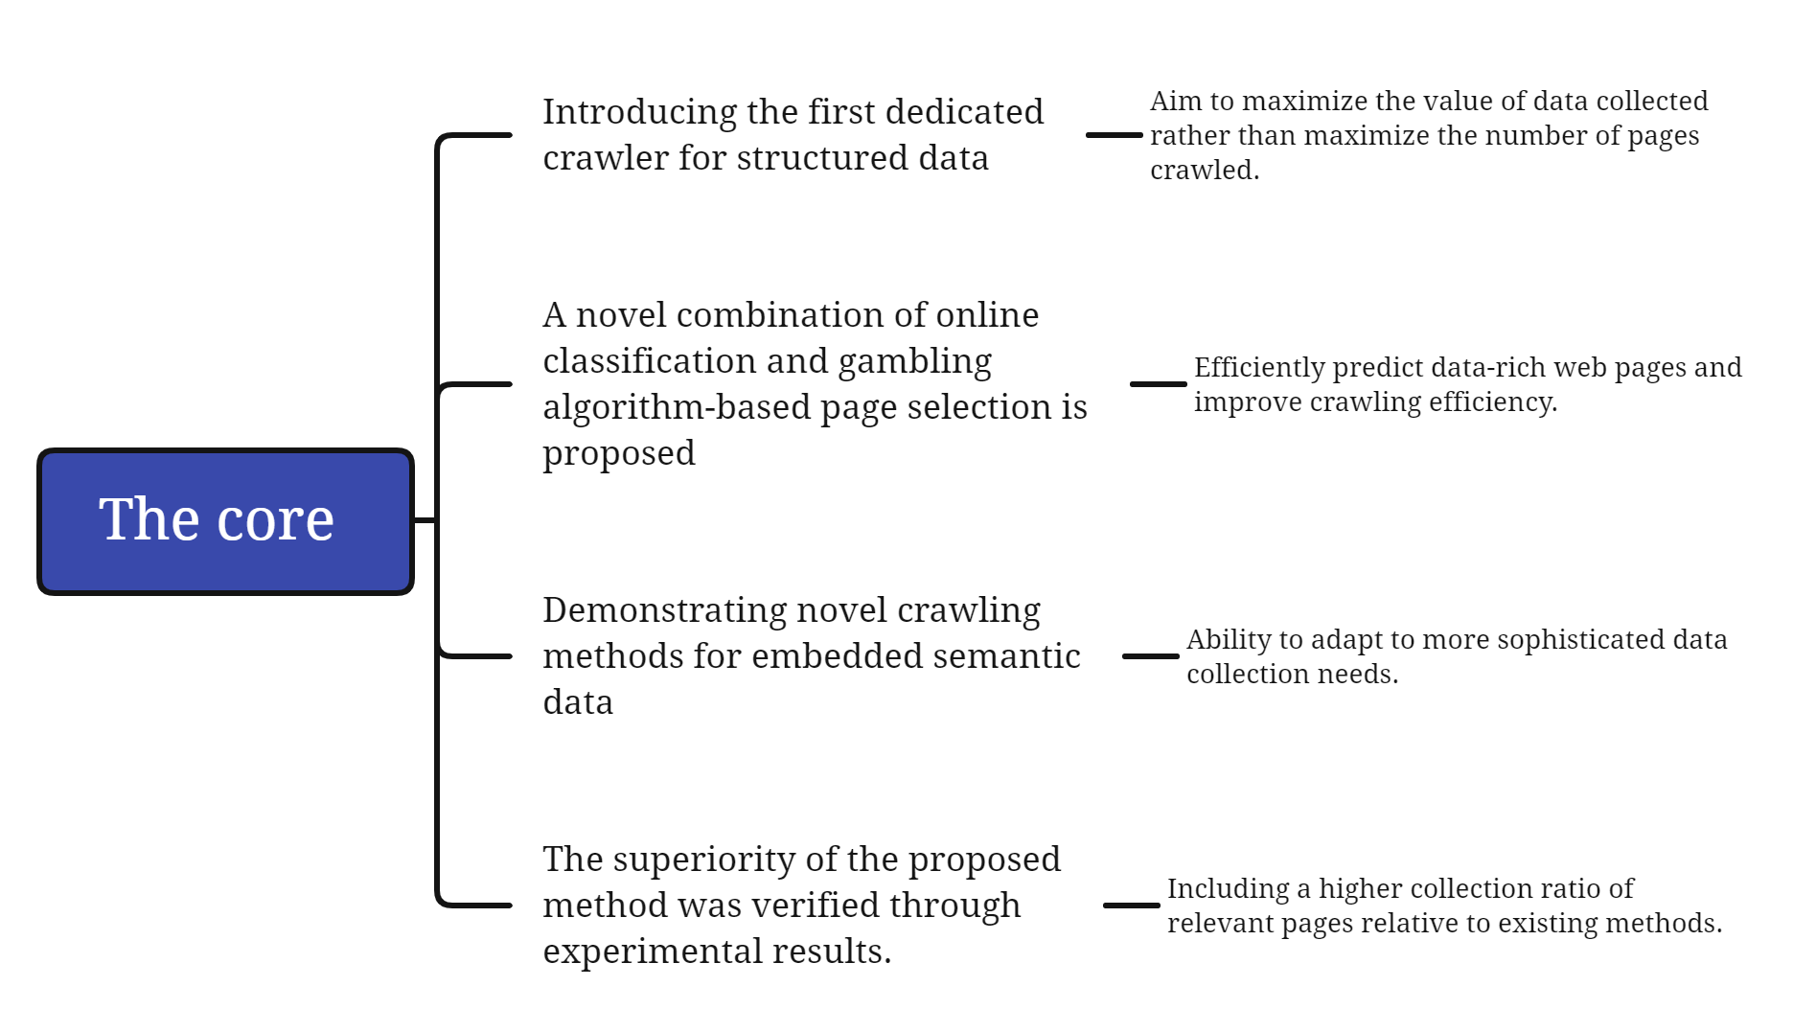
What I understand about this paper
SECTION TITLE | 2
SECTION TITLE | 2

Slide 3
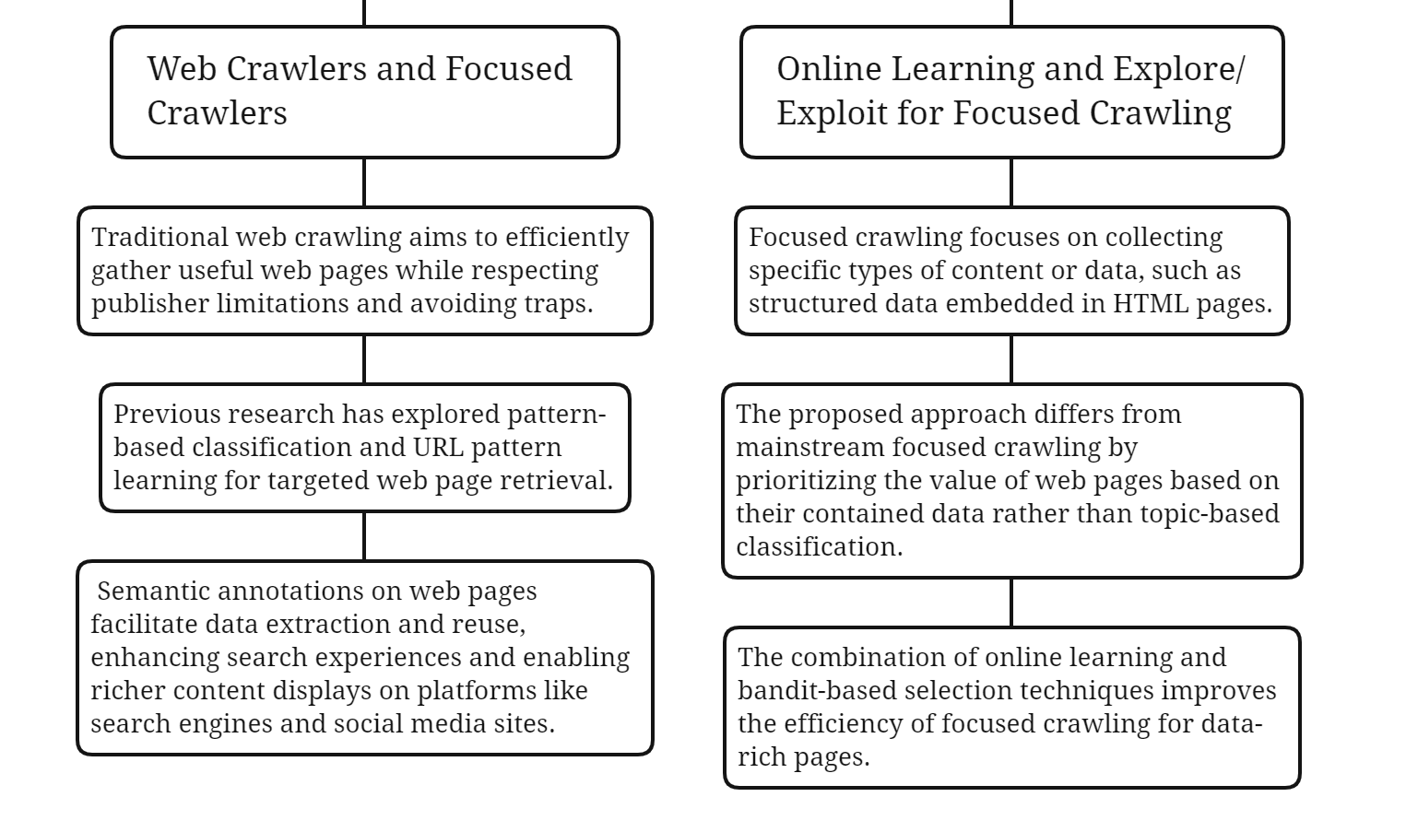
Discussion of related work and background

Slide 4
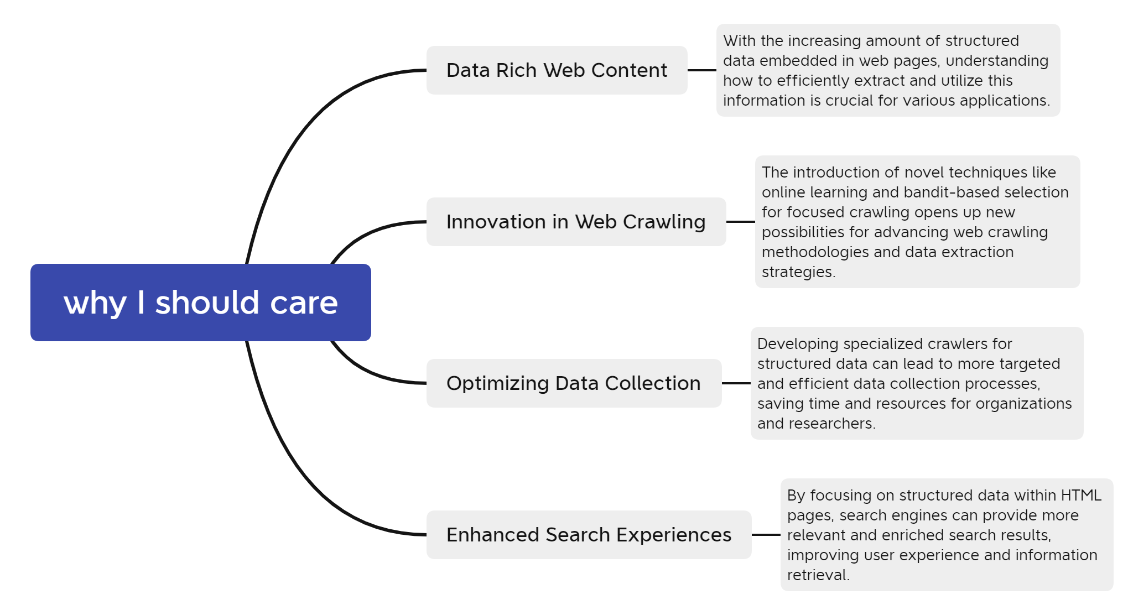
Discussion of why I should care about the topic

Slide 5
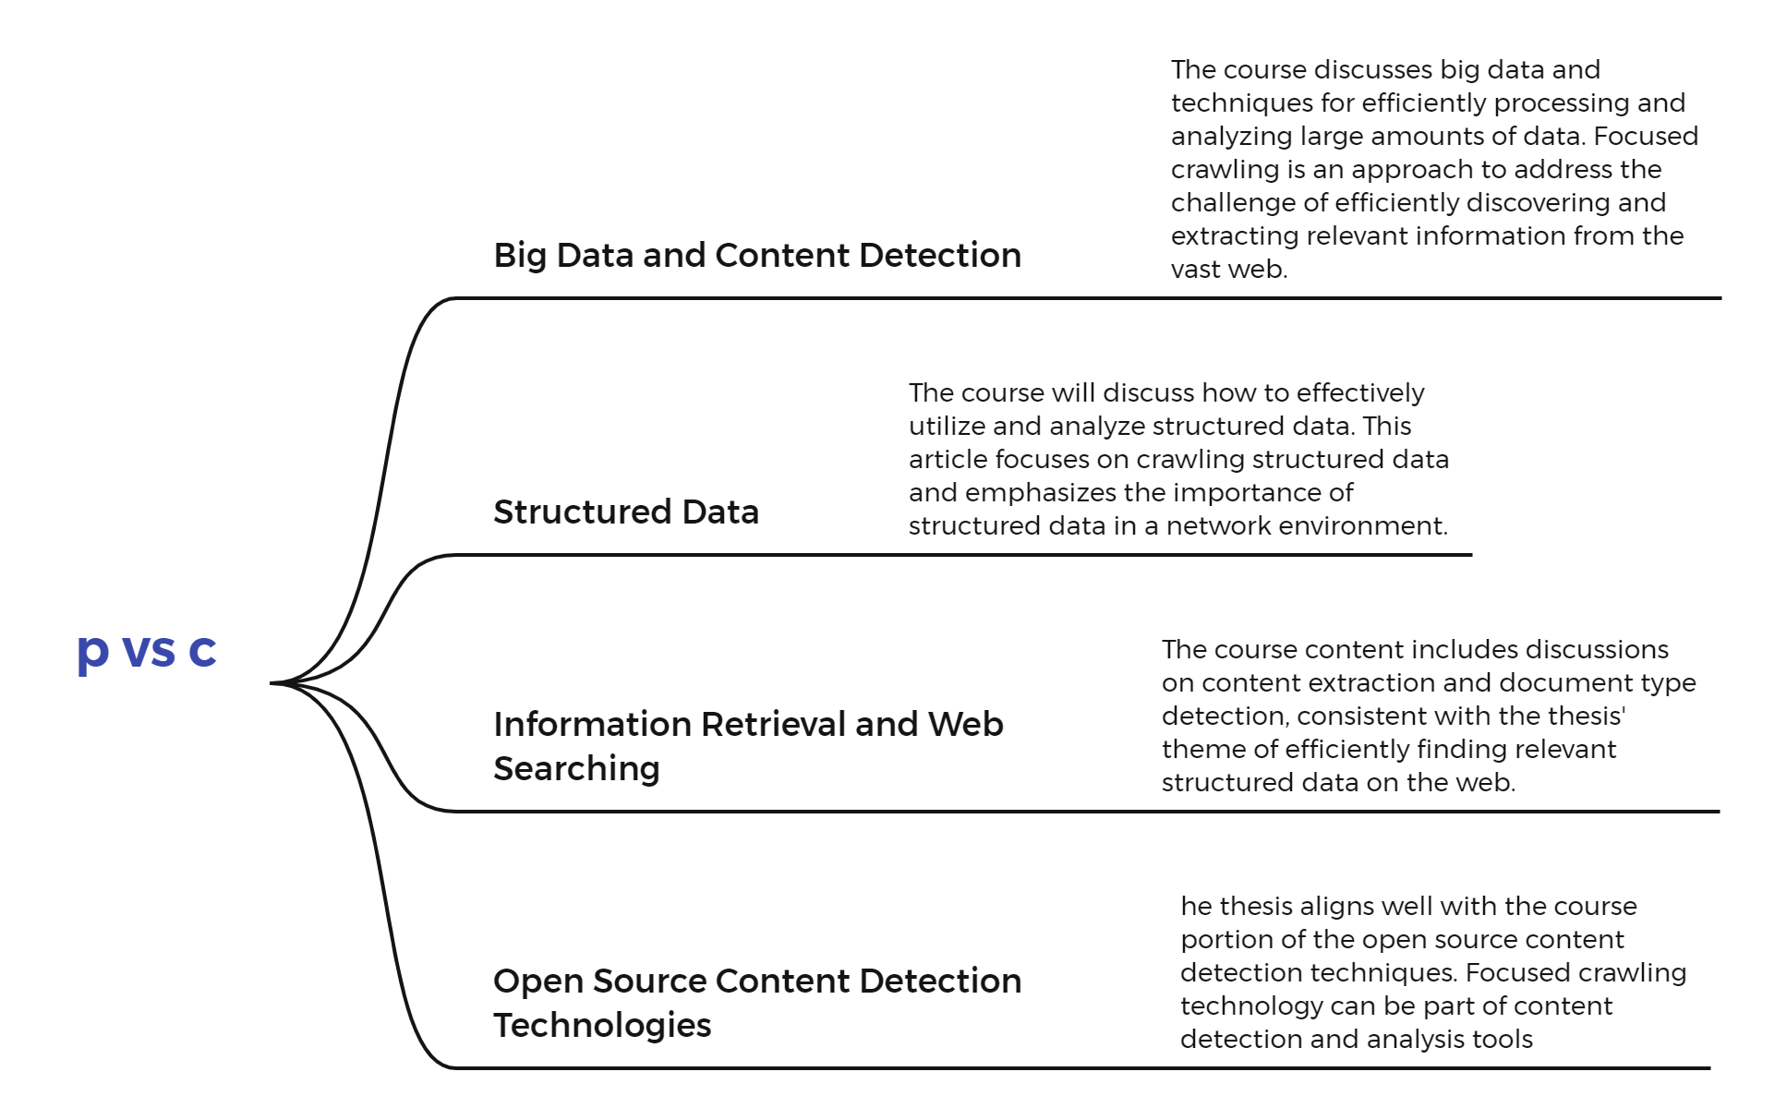
Relevant points between this paper and the class

Slide 6
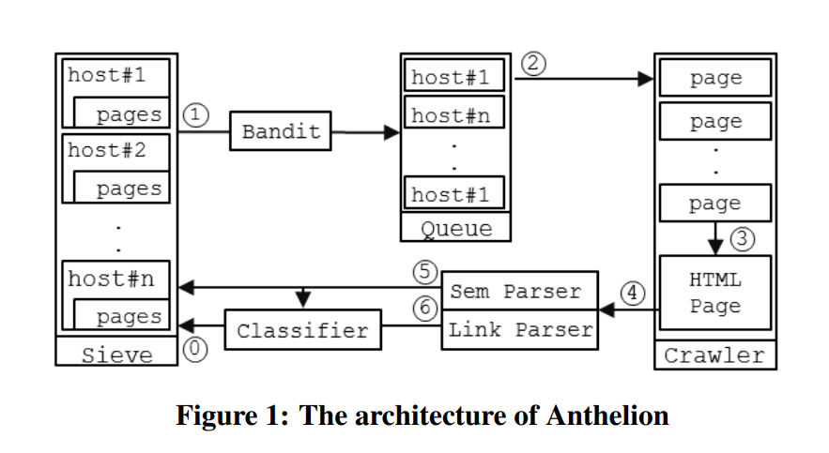
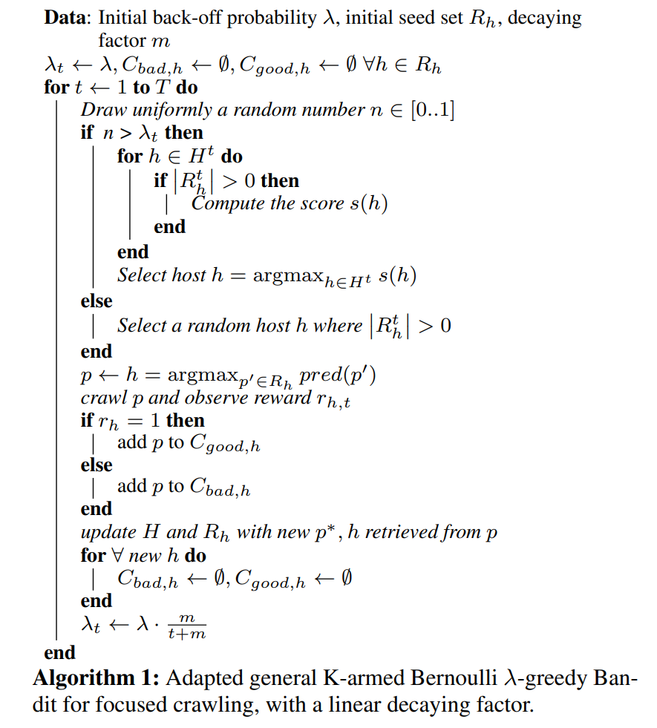
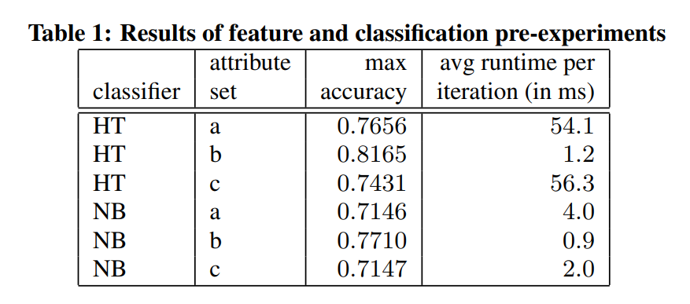
Summary and introduction of algorithms or technologies

Slide 7
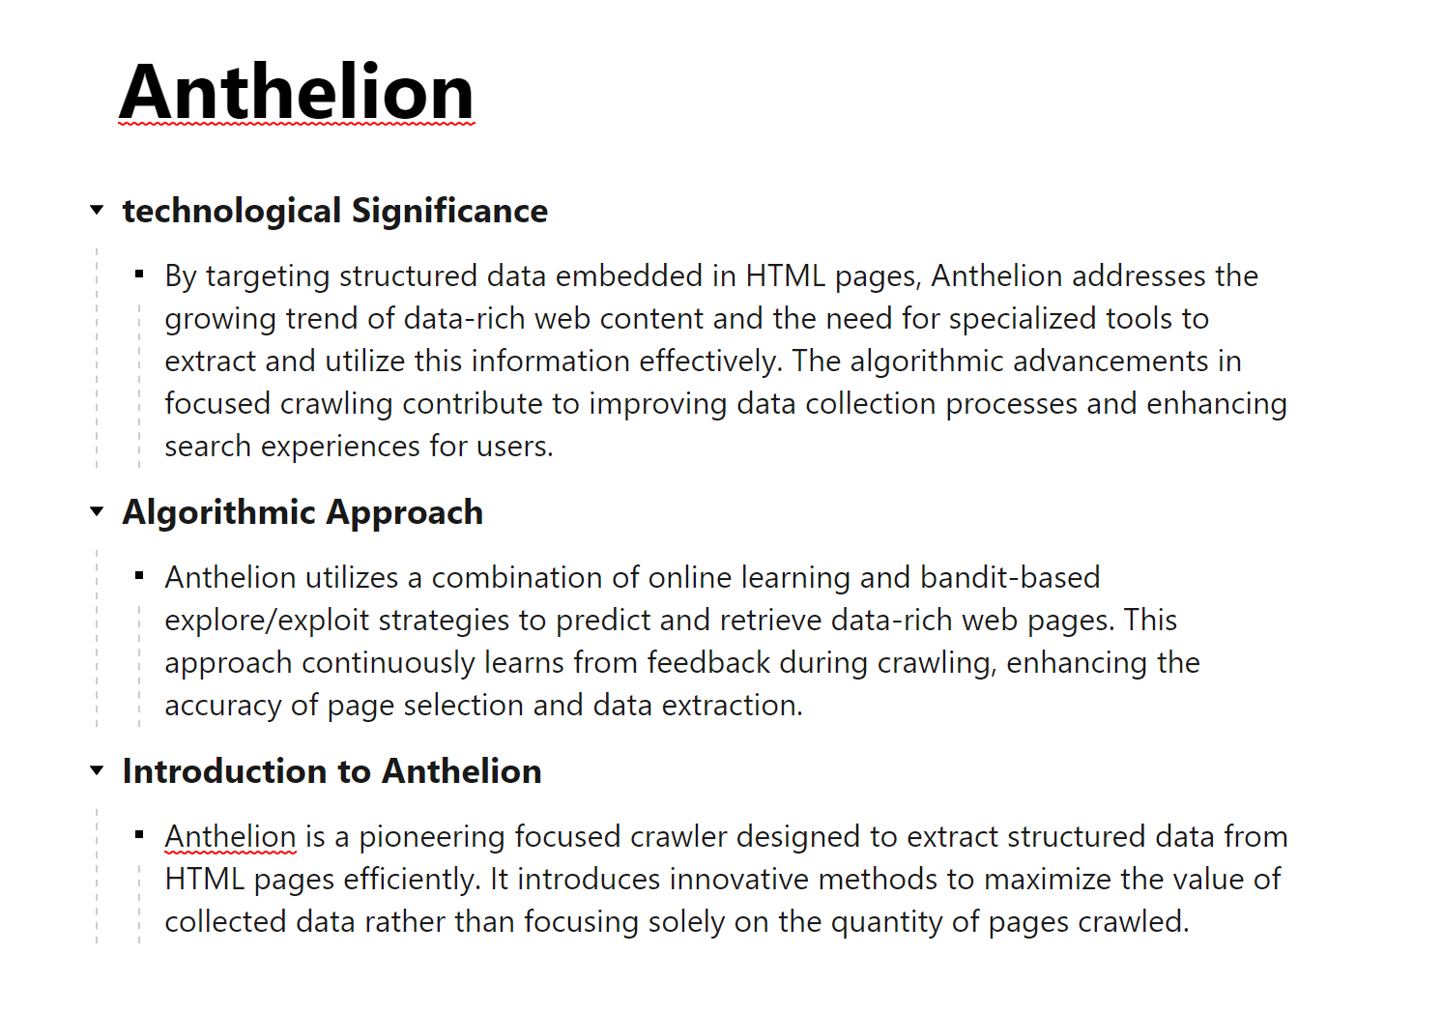
Summary and introduction of algorithms or technologies

Slide 8
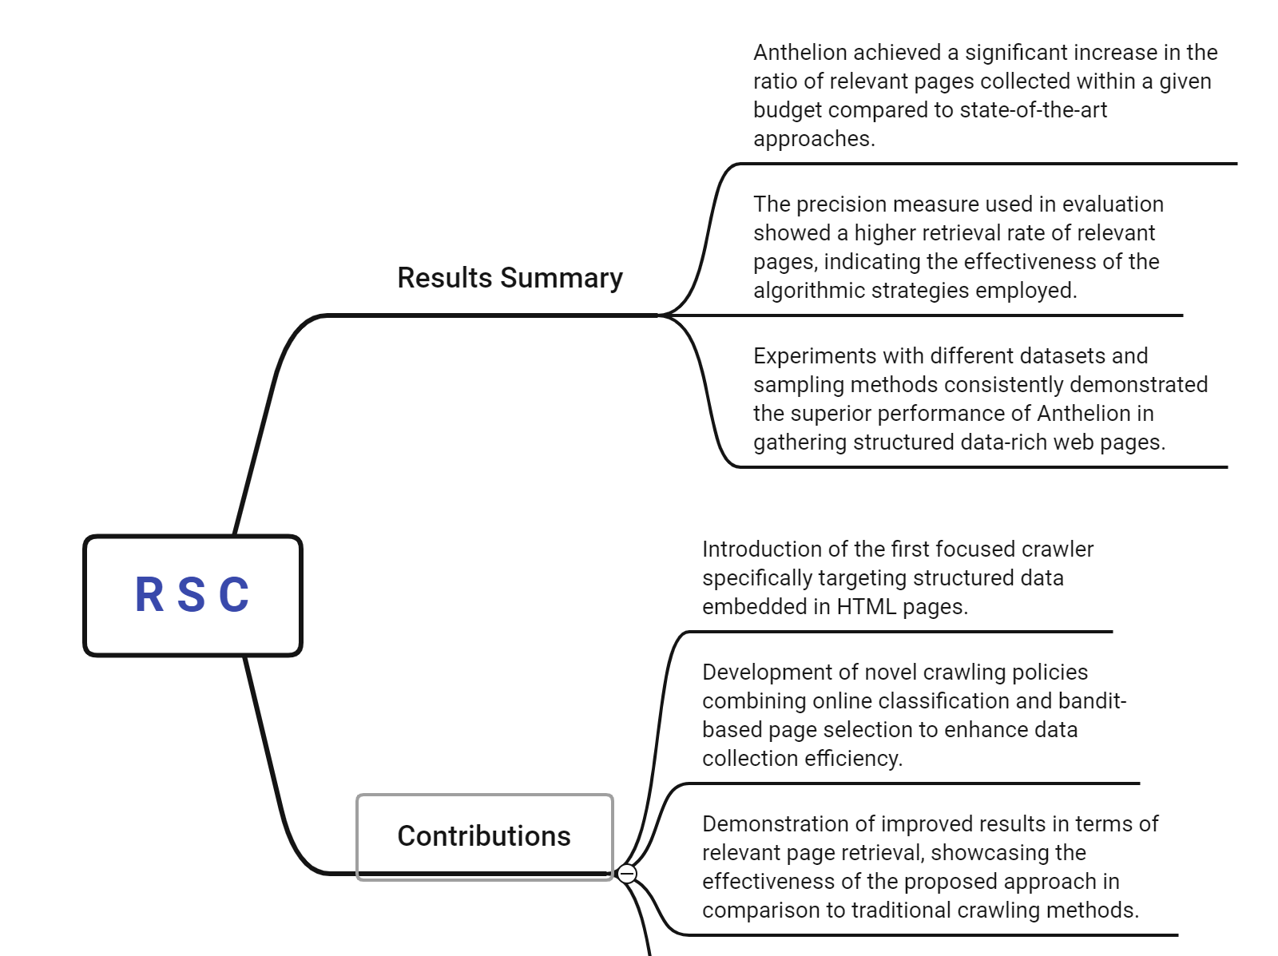
Results, summary and contributions of the paper

Slide 9
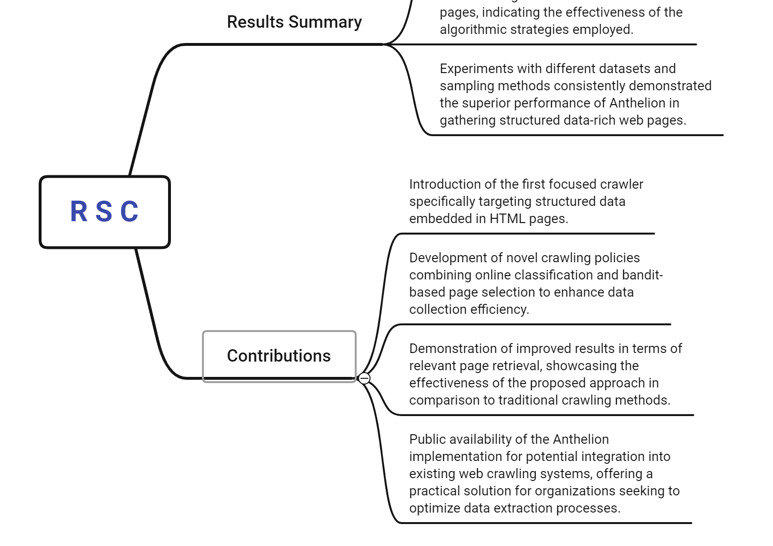

Slide 10
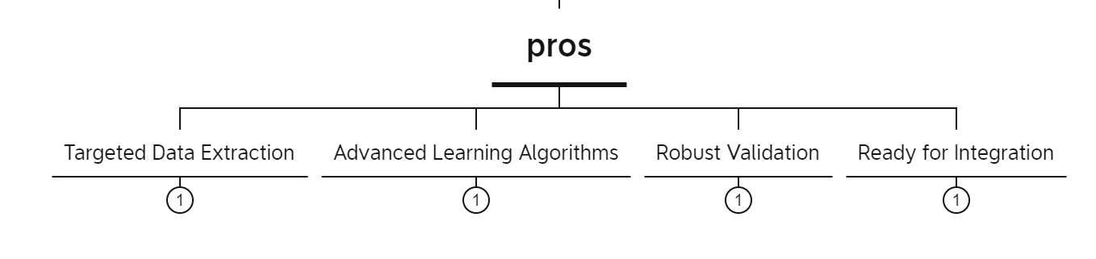
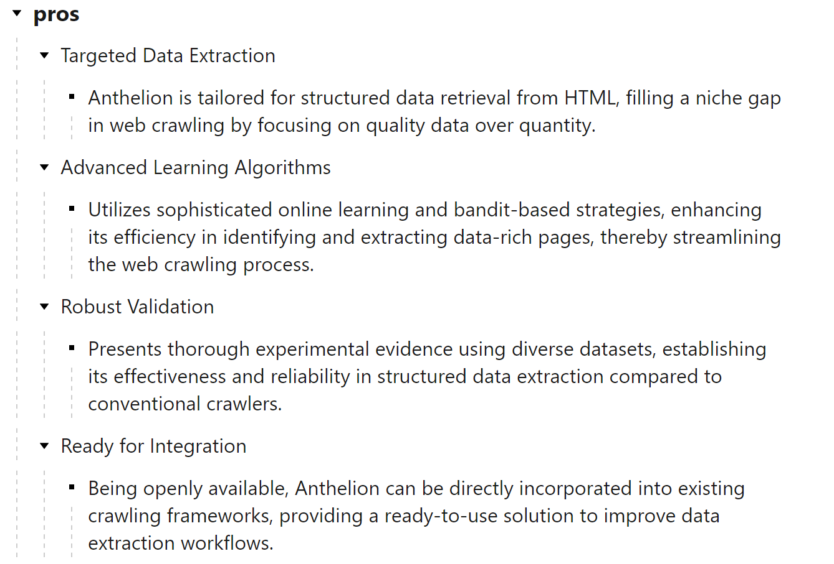
Evaluate the pros and cons of the paper

Slide 11
